Slide 1
Data Science Engineering Methods and Tools – INFO 6105 SMOTE(Synthetic Minority Over-sampling Technique)
Presented by: Chi-Yao Hsiao

Slide 2
Over-Sampling v.s. Under-Sampling
Person_id | Diabetes
A | 0
B | 0
C | 0
D | 0
E | 0
F | 0
G | 0
H | 0
I | 0
J | 1
K | 1
J’ | 1
K’ | 1
J’’ | 1
K’’ | 1
J‘’’ | 1
K’’’ | 1
Person_id | Diabetes
A | 0
B | 0
C | 0
D | 0
E | 0
F | 0
G | 0
H | 0
I | 0
J | 1
K | 1
Person_id | Diabetes
A | 0
B | 0
C | 0
D | 0
E | 0
F | 0
G | 0
H | 0
I | 0
J | 1
K | 1
This is typical imbalanced data
which contain only 2 people have diabetes.
Over-sampling: Increasing the number of samples in the minority class to balance the dataset.
Under-sampling: Reducing the number of samples in the majority class to balance the dataset.

Slide 3
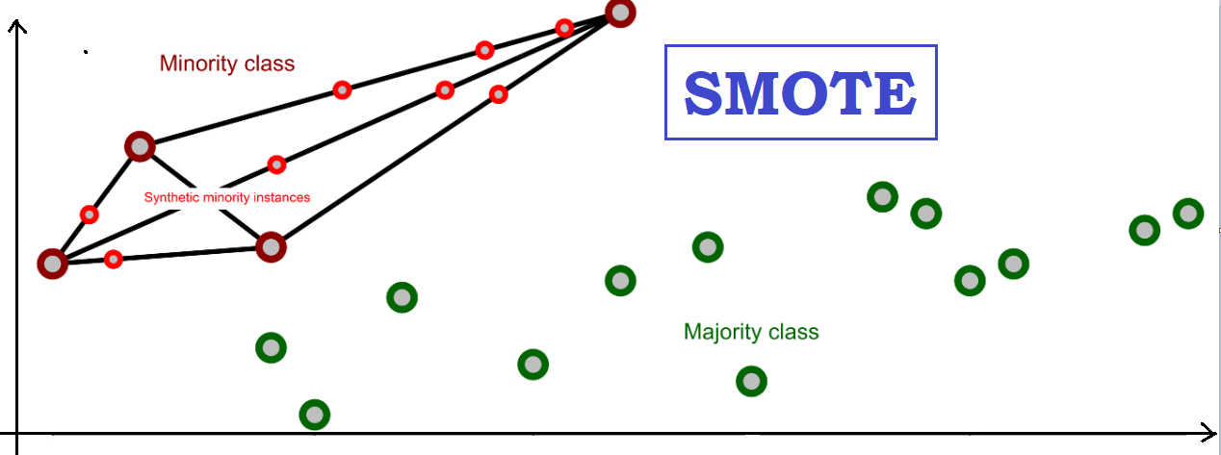
Definition of SMOTE
creates synthetic samples for the minority class by interpolating between existing data points, helps balance the dataset without simply duplicating samples.

Slide 4
Example of SMOTE
Person_id | Age | Smoke | BMI | Diabetes
A | 11 | 0 | 22.1 | 0
B | 15 | 0 | 25 | 0
C | 23 | 0 | 23 | 0
D | 28 | 1 | 30.5 | 1
E | 33 | 1 | 28.6 | 0
F | 42 | 1 | 35 | 1
G | 50 | 1 | 18 | 0
Person_id | Age | Smoke | BMI | Diabetes
A | 11 | 0 | 22.1 | 0
B | 15 | 0 | 25 | 0
C | 23 | 0 | 23 | 0
D | 28 | 1 | 30.5 | 1
E | 33 | 1 | 28.6 | 0
F | 42 | 1 | 35 | 1
G | 50 | 1 | 18 | 0
H | 35 | 1 | 32.75 | 1
I | 38.5 | 1 | 33.875 | 1
J | 31.5 | 1 | 31.625 | 1
H = (D + F) / 2
I = (F + H) / 2
J = (D + H) / 2

Slide 5
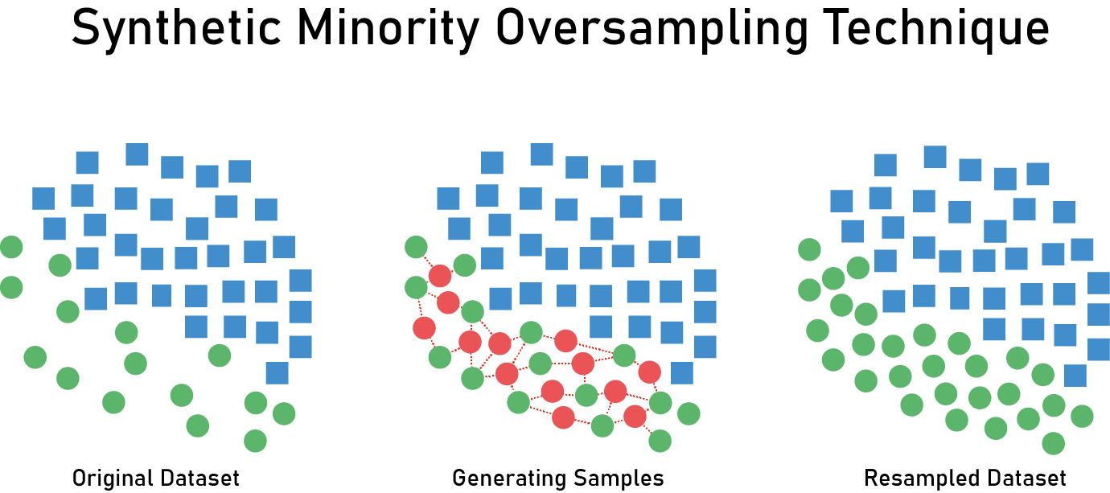
Visualization of SMOTE

Slide 6
Strength and Weakness of SMOTE
Strength:
Reduce the risk of overfitting
Improve minority class prediction performance
Balanced data set
Weakness:
May introduce noise
Blurred category boundaries
Calculate the cost
Notes:
1. SMOTE generates synthetic samples rather than repeated original samples, which helps reduce the risk of overfitting because the model does not rely on repeated data from only a few classes.
2. By increasing the number of minority class samples, SMOTE enables the model to learn more features of the minority class, thereby improving the prediction performance of the minority class.
3.SMOTE can effectively balance the number of samples in the minority and majority classes in the data set, thereby improving the accuracy and stability of the model when dealing with imbalanced data sets.
The synthetic samples generated by SMOTE are based on interpolation between existing samples, which may introduce noise in some cases, especially when there are anomalies or errors in minority class samples.
Synthetic samples may blur the boundaries between different categories, making it possible for the model to have difficulty learning category distinctions, especially when there are overlapping category regions in the dataset.
SMOTE requires calculating distances between samples when generating synthetic samples, which may increase computational cost and memory usage, especially for large data sets.

Slide 7
Resources
https://iq.opengenus.org/smote-for-imbalanced-dataset/
https://medium.com/@parthdholakiya180/smote-synthetic-minority-over-sampling-technique-4d5a5d69d720
Thank you for listening

